Slide 1

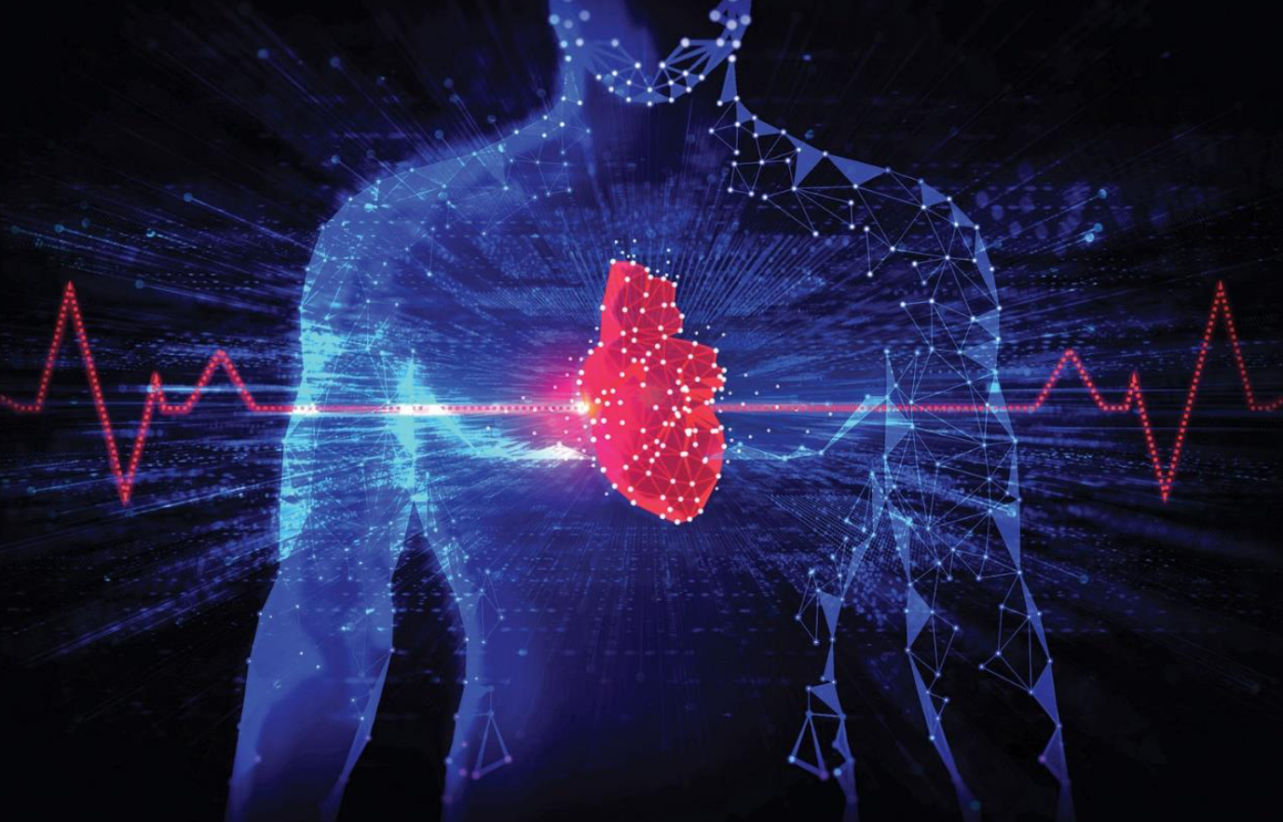
Myocardial infarction: A Machine Learning Approach
Authors:
Omer Kriger and Nir Peretz
Advisors: Prof. Adi Shraibman Dr. Dorit Shweiki Dr. Yonatan Bilu

Slide 2
Agenda
Introduction
Problem Statement
UK Biobank
Data Visualization
Solution Description
Process
Features
Results
Conclusions
Future Work

Slide 3
Introduction
Myocardial infarction (MI), commonly known as a heart attack, is one of the leading causes of morbidity and mortality globally
MI occurs when blood flow to a part of the heart is blocked for a prolonged period, resulting in tissue damage. Therefore, early detection and intervention are crucial in mitigating its impact.
Various risk factors contribute to heart attacks, making early diagnosis of individuals at risk essential for preventive interventions.
The purpose of this study is early diagnosis of individuals at risk of experiencing a myocardial infarction in the future.
Notes:
ניר – לדבר על השתי נקודות הראשונות

Slide 4

Interest In The Subject
Global Health Importance:
Major cause of mortality worldwide.
Significant public health concern.
Universal Risk:
MI can affect almost anyone, regardless of age or lifestyle.
Many individuals are unaware of their risk until it’s too late.
Importance of Early Detection:
Early awareness can significantly reduce the risk of severe outcomes.
Notes:
ירד בעריכה

Slide 5
Problem Statement
Identifying individuals at risk of myocardial infarction is challenging with current methods, potentially resulting in missed opportunities for early intervention and improved outcomes.
Notes:
עומר – בשיטות הנפוצות היום מאתגר לעשות זיהוי מוקדם של פרטים אשר בסיכון להתקף לב

Slide 6
Machine Learning
A subset of AI that enables computers to learn from data without explicit programming.
Capabilities:
Analyzes vast datasets (e.g., patient demographics, clinical parameters, genetic markers, imaging).
Identifies intricate patterns and relationships beyond conventional methods.
Approaches:
Supervised Learning: Uses labeled data to predict outcomes (e.g., myocardial infarction likelihood).
Unsupervised Learning: Analyzes unlabeled data to uncover hidden patterns (e.g., patient subgroups).
Both methods aid in early diagnosis and personalized treatment strategies.
Notes:
ירד בעריכה

Slide 7
UK BioBank
Large-Scale Biomedical Database: Established in the UK.
Participants: Over 500,000.
Data Collected:
Health assessments (physical measurements, biological samples).
Lifestyle, medical history, and socio-demographic questionnaires.
Aim: Improve prevention, diagnosis, and treatment of diseases.
Usage: Global research on disease causes, risk factors, and new treatments.
Notes:
לדבר בקצרה, לא נדרש להרחיב בנושא

Slide 8
Data Characteristics

Slide 9
Solution Description
Aims & Objectives:
Develop a predictive model using machine learning to assess Myocardial Infarction (MI) risk.
Analyze diverse datasets to enhance early awareness and preparedness for potential treatment.
Notes:
עומר – להקריא זריז את הראשון בלבד.

Slide 10





Process
Data preprocessing
Training The Model
Learning the dataset
Model Selection
Model Evaluation
Notes:
ניר – ראשון ושני
עומר שלישי רביעי חמישי
לרוץ מהר !!!!

Slide 11
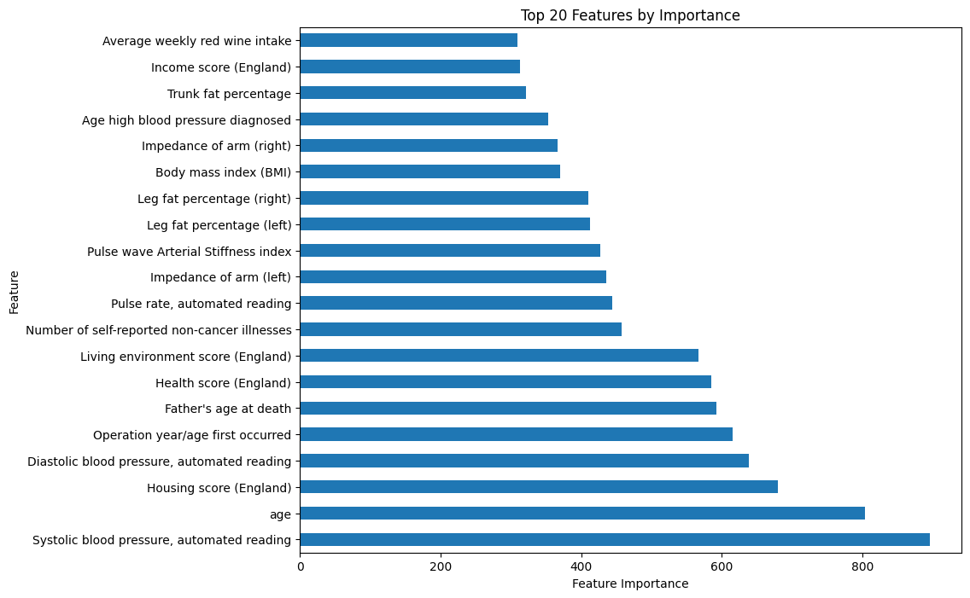
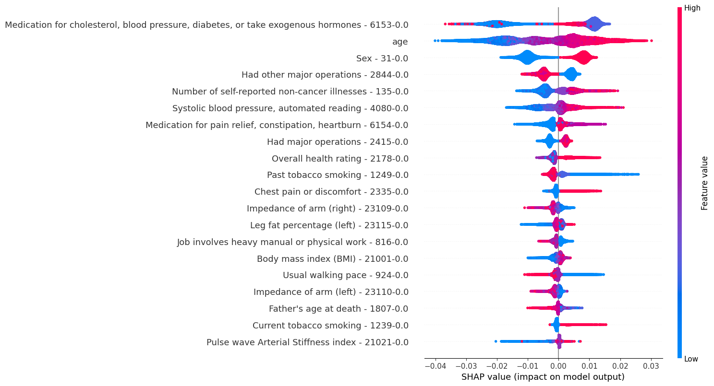
Features

Slide 12
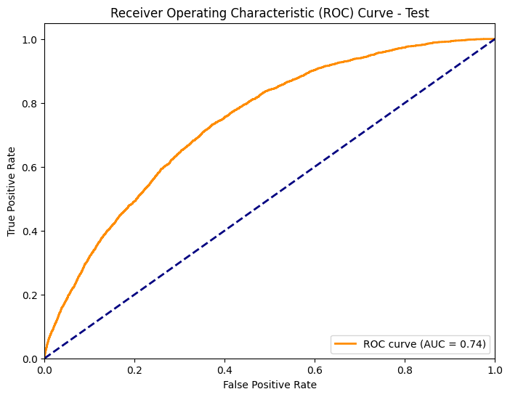
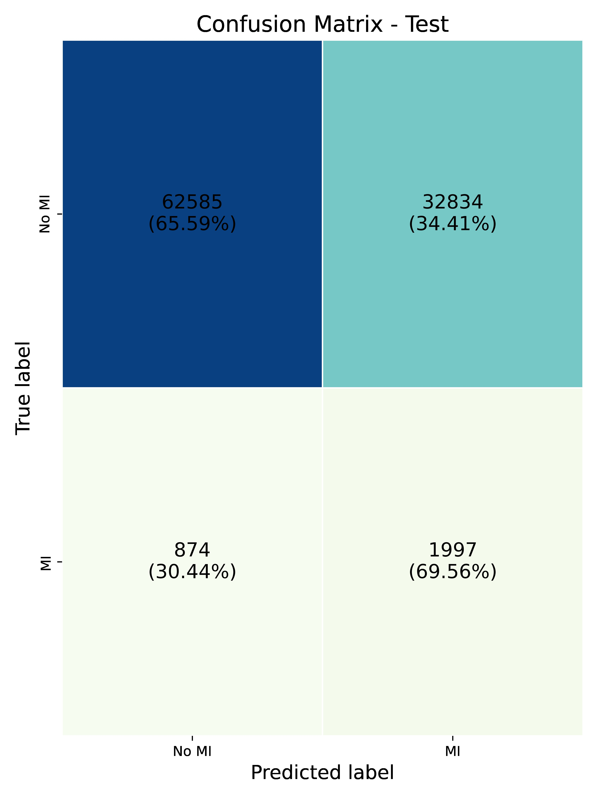
Results
ROC Curve (Upper Image):
The model achieved an Area Under the Curve (AUC) of 0.74, showing it can reasonably distinguish between positive and negative cases.
The curve's proximity to the diagonal line suggests moderate predictive performance, balancing True Positive Rate and False Positive Rate.
Confusion Matrix (Lower Image):
The model correctly identified 62,585 true negatives (No MI) and 1,997 true positives (MI), showing a good ability to detect true cases.
However, the model produced 32,834 false positives, revealing a tendency to misclassify non-MI cases as MI. Additionally, the 874 false negatives, which represent missed MI cases, are particularly concerning due to their critical implications for patient safety.
Notes:
עומר – עליון – הגרף כמור וסימטרי מראה שיש תהליך לא רע של למידת המודל והשטח
ניר – תחתון

Slide 13
Conclusions
The low representation of myocardial infarction (MI) cases (2%) made it challenging to train the model effectively.
Despite these challenges, the model showed reasonable accuracy in predicting both MI and non-MI cases.
This study underscores the difficulties of using machine learning to predict MI but also demonstrates the model's potential for improvement beyond random guessing.
Notes:
עומר – לדבר בעיקר שתי הראשונים
השלישי לתמצת

Slide 14
Future Work
Predictor Goal: Develop a model to predict the specific time range during which a MI is likely to occur.
Advanced Sampling: Combine over-sampling and under-sampling to tackle dataset imbalance.
Improve Preprocessing: Refine feature selection by removing noise and using model insights (e.g., Feature Importance, SHAP) to understand feature impact.
Test More Models: Explore Neural Networks (e.g., CNN, RNN), try different models and ensemble methods (e.g., CAT-Boost, SVM) for better performance.
Notes:
ניר – נקודה שניה, לדייק את בחירת הפיצטרים
השלישי לסיים אחרי רשתות

Slide 15
Thank you
Omer Kriger & Nir Peretz

